Slide 1


Santosh Kumar Kar,
skkar.2k2@gmail.com

Slide 2
CHAPTER – 3
Spring AOP

Slide 3
Aspect Oriented Programming
Breaks the program logic into distinct parts (Called concerns).
Used to increase modularity by cross-cutting concerns.
cross-cutting concern is a concern that can affect the whole application and should be centralized in one location in code as possible, such as transaction management, authentication, logging, security etc.

Slide 4
Join point
Advice
Pointcut
Introduction
Target Object
Aspect
Interceptor
AOP Proxy
Weaving

Slide 5
Joint Point
method execution,
exception handling,
field access etc.
Spring supports only method execution join point.

Slide 6
Advice
An action taken by an aspect at a particular join point
Before Advice: executes before a join point.
After Returning Advice: executes after a joint point completes normally.
After Throwing Advice: executes if method exits by throwing an exception.
After (finally) Advice: executes after a join point regardless of join point exit whether normally or exceptional return.
Around Advice: executes before and after a join point.

Slide 7
Pointcut
An expression language of AOP that matches join points.

Slide 8
Aspect
Class that contains
advices,
joinpoints.

Slide 9
Interceptor
An aspect that contains only one advice

Slide 10
Weaving
It is the process of linking aspect with other application types or objects to create an advised object. Weaving can be done at compile time, load time or runtime. Spring AOP performs weaving at runtime.

Slide 11
AOP implementations
AspectJ
Spring AOP
JBoss AOP

Slide 12
Spring AOP with xml config
4 types of advices
Before Advice
MethodBeforeAdvice
After Advice
AfterReturningAdvice
ThrowsAdvice
Interceptor
MethodInterceptor

Slide 13
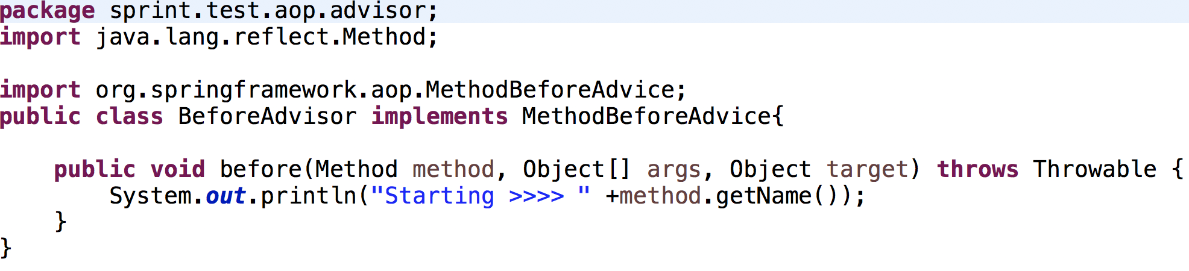
MethodBeforeAdvice

Slide 14
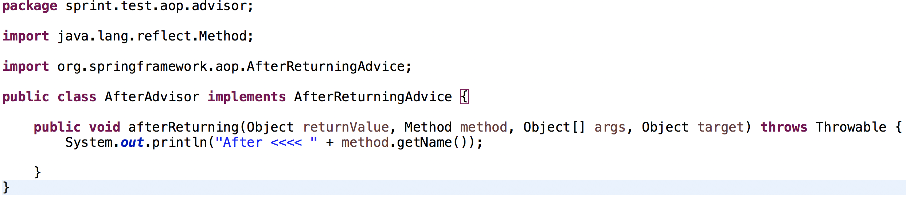
AfterReturningAdvice

Slide 15
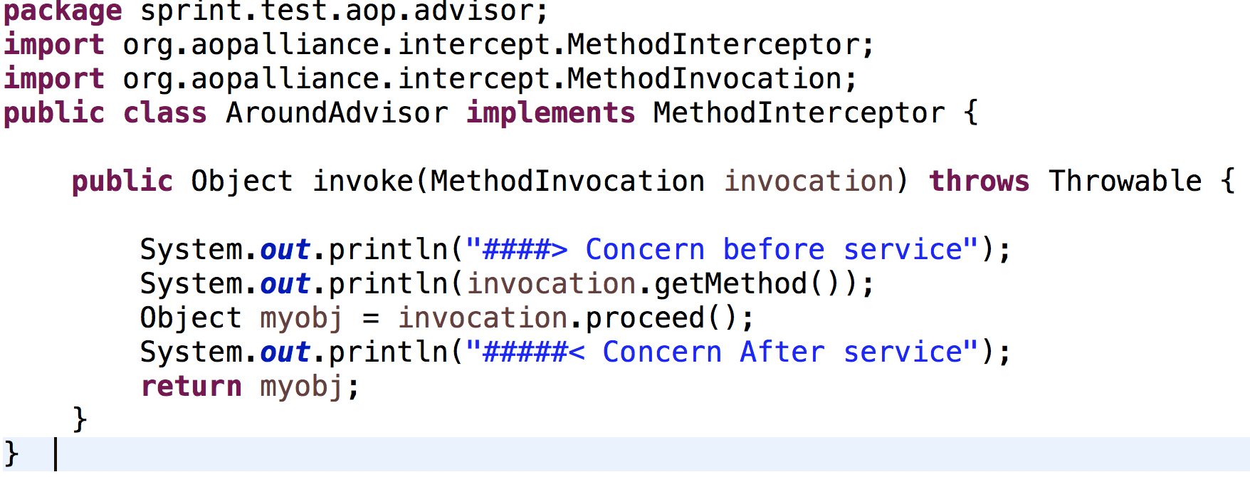
MethodInterceptor

Slide 16
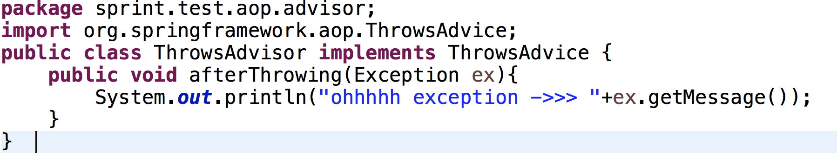
ThrowsAdvice

Slide 17
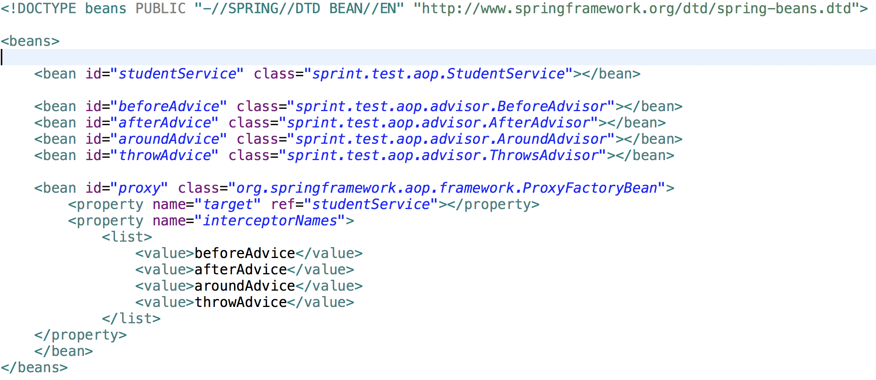
AOP config

Slide 18
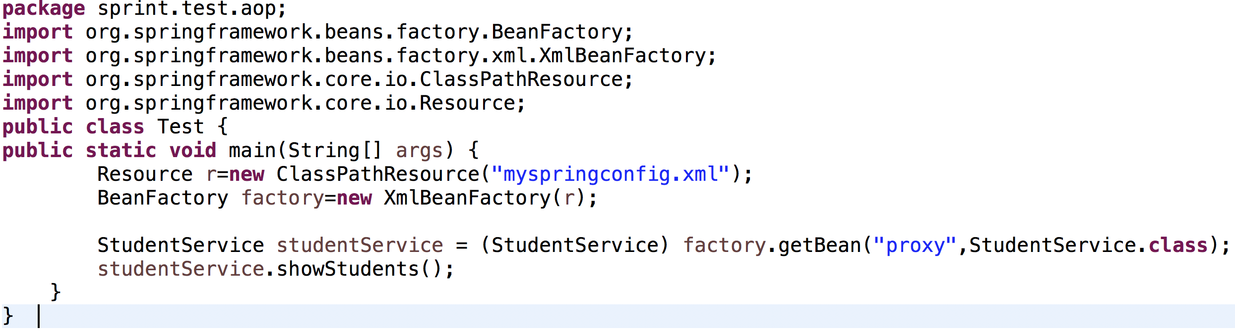
Final Execution

